Slide 1
91907 COMPLEX PROCESSES TO DEVELOP AN OUTCOME L3
2021 MAGS
Evidence of Learning Template
Alex Chu
YOUR NSN NUMBER HERE

Slide 2
91906 - 91907 Complex Programming
Please add links to your work on this slide. Then remove this instruction. Note that most of the instructions have been supplied as speaker notes for later reference :)
The project on Github or Drive: <insert link here>
Notes:
Please add links to your work on this slide

Slide 3
Project management: Setup
For planning I used Trello. This is because Trello is free and easy to use, I can set up plan for each week through columns. This planning way is very easy to read and track my work progress to make sure Im not missing anything.
I used Github to store all of my work. This is because Github is a reliable website, most programmers use it to store their work and also I can easily access to these files in the future and easy to share my work with others.
Trello helped me stick on with my work, as I planned so I just followed it to make sure I’m doing this in the correct order.
Github helped me store all of my file and it can compress all of it into a zip file so that other people can download and view my code.

Slide 4
Addressing Relevant Implications
Implications text goes here

Slide 5
Graphical User Interface Design...
Create wireframes for your program’s GUI. Please place them on this slide.
Notes:
Create wireframes for your program’s GUI. Please place them on this slide.

Slide 6
Program Structure
There’re 3 main parts. First is the bot itself (brain), second is the gui, third is the database.
Brain: the brain is programmed to answer all of the question about python, such as “what is flask” and it will give a definition of it to user. It can also used as a simple chat bot because I programmed it to respond to some basics like “hello”.
Gui: The gui will be the part that you run to open the program. By importing the Brain (bot.py) to this file I was able to put the bot inside the gui. There are 3 main parts, the chat window where it displays the chat, the text input where user input questions and finally the “Send Button”.
other are just menu which I added to make the gui more complete.
Data Base: This will be 2 text files where it store all of the answers the bot needed to respond back when ask. Using similarity method, the bot will find keyword from the question then find that key word in its data base and give an answer
Notes:
Create a diagram showing your program’s structure and outline the classes and functions that you plan on developing. You are welcome to edit this slide once you start developing the outcome BUT when you do that, you should show what has changed and explain why those changes were needed.

Slide 7
Problem Decomposition
Notes:
Provide evidence showing that you have decomposed the task. This can be in the form of a trello screenshot or a list of components. If necessary, you may revisit this slide and add to it / edit it as you create your outcome. When you make changes to this slide, please do so in a different colour, date the changes and explain why they were made (this can help provide evidence for M / E grades).
Hint: Use the structure you developed earlier to work out what components you need. For each function, you should have at least one component.

Slide 8
Develop your Components!!
Make as many copies of the next three slides as you need. For each component you should have…
A trello screenshot / evidence of ongoing use of your project management tools
A test plan for the component that has been created BEFORE you start coding. Your plan should allow you to test all logical pathways for this component. It should also include test cases for relevant boundary and unexpected values.
Screenshot evidence showing that you have worked through the test plan you developed.
You should also provide evidence of trialling multiple components & techniques. Please make slides as needed for that evidence.

Slide 9
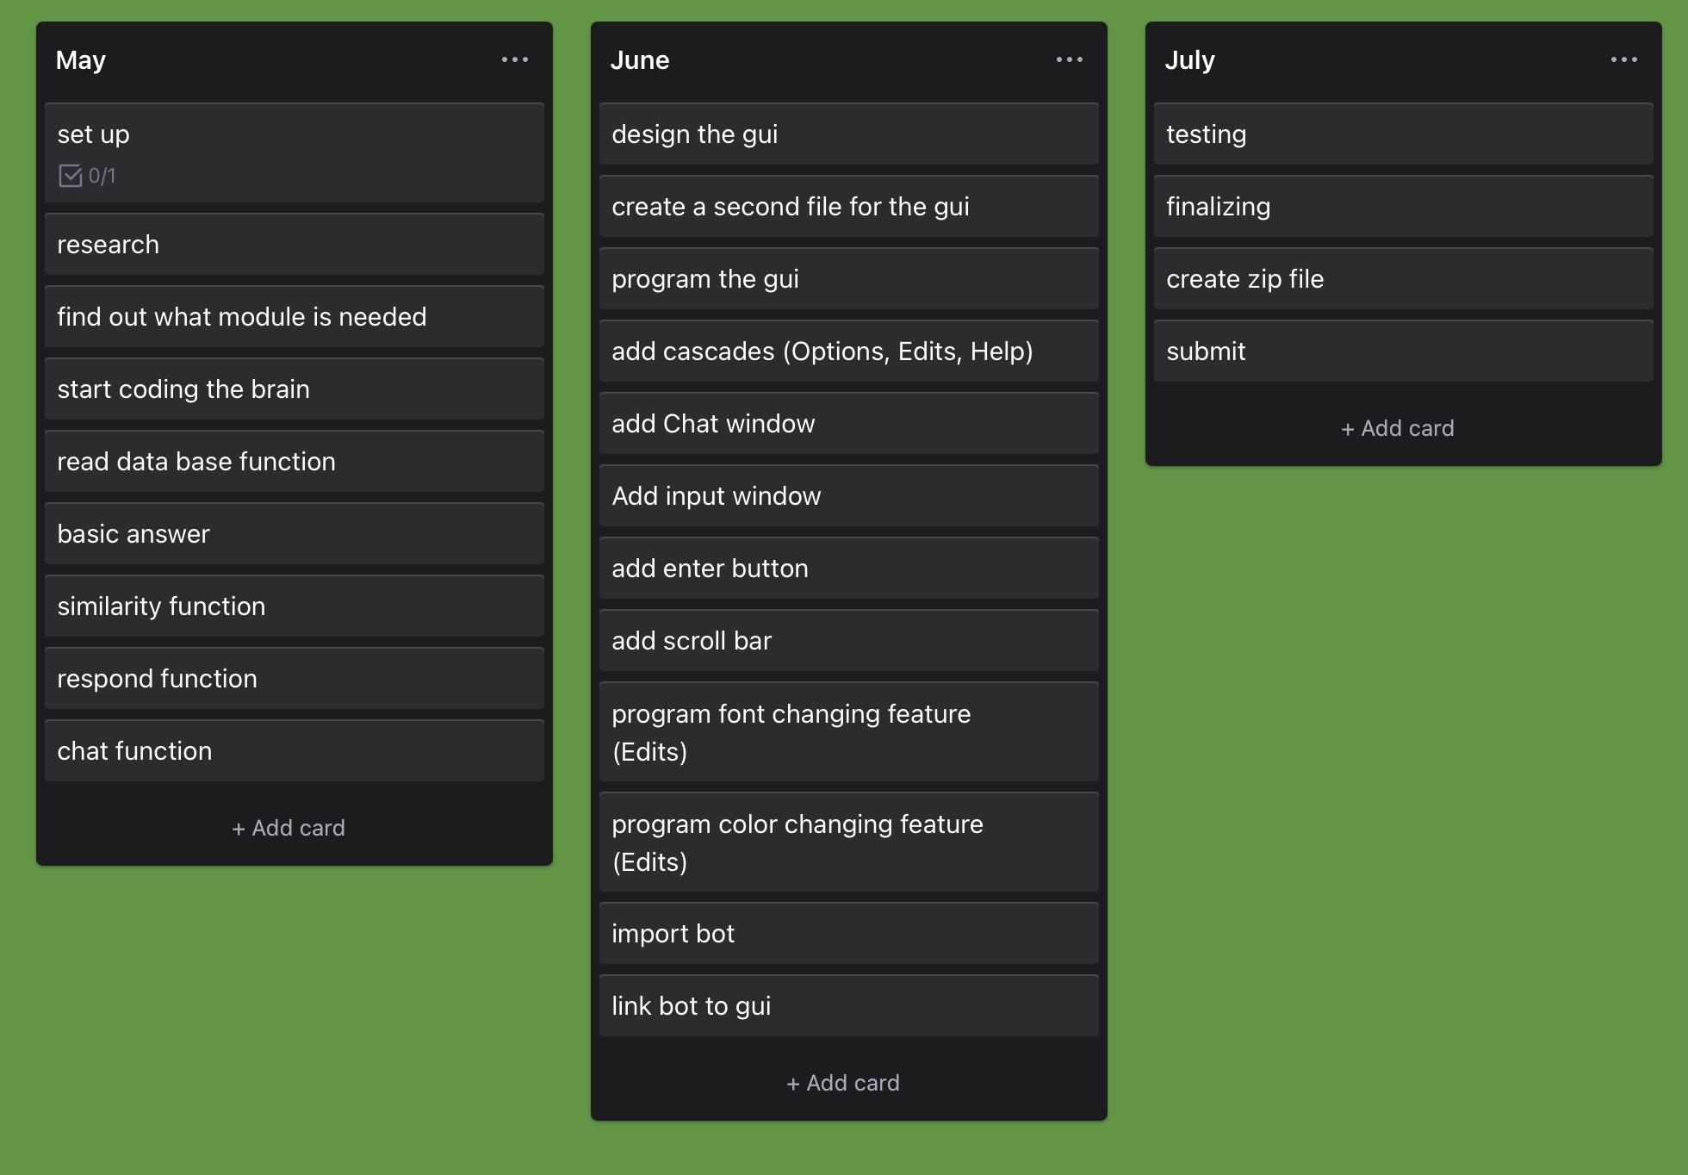
Component Planning...
Notes:
Duplicate this slide and use it to show your planning for the current component. This could be in the form of a trello screenshot.

Slide 10
Component Test Plan <Edit Me>
Create a test plan for this component BEFORE you start coding. Your plan should allow you to test all logical pathways for this component. It should also include test cases for relevant boundary and unexpected values.
Notes:
Create a test plan for this component BEFORE you start coding. Your plan should allow you to test all logical pathways for this component. It should also include test cases for relevant boundary and unexpected values.

Slide 11
Component Testing Evidence <Edit Me>
Use this slide to provide evidence that you have tested your component in accordance with the test plan you developed earlier.
Notes:
Use this slide to provide evidence that you have tested your component in accordance with the test plan you developed earlier.

Slide 12
Complete Program...
Assemble your components into a working program. On the slides that follow, please provide a test plan and evidence that your program works as expected.
If you are going for M / E, you also need to create extra slides showing how you have used your testing to improve the functionality of your program. This could mean having multiple test plans (and screenshots) showing several iterations of the assembled program.
Notes:
Use this slide to provide evidence that you have tested your component in accordance with the test plan you developed earlier.

Slide 13
Complete Program <test plan>
Use this slide to provide a test plan for your complete program. You may wish to create multiple slides so that you can test for expected, boundary and unexpected cases.
Remember to test ALL logical pathways so that you can ensure your program works correctly.
Notes:
Use this slide to provide a test plan for your complete program. You may wish to create multiple slides so that you can test for expected, boundary and unexpected cases.
Remember to test ALL logical pathways so that you can ensure your program works correctly.

Slide 14
Complete Program <testing evidence>
Create as many slides as needed to provide evidence of testing that your outcome works for expected, boundary and unexpected cases. If you wish, you are welcome to submit a brief video showing your testing.
Notes:
Use this slide to provide a test plan for your complete program. You may wish to create multiple slides so that you can test for expected, boundary and unexpected cases.
Remember to test ALL logical pathways so that you can ensure your program works correctly.

Slide 15
Relevant Implications Addressed
You might wish to use this slide to explain how you have addressed the relevant implications if you have not done so in previous slides.
Comments go here
Notes:
You might wish to use this slide to explain how you have addressed the relevant implications if you have not done so in previous slides.

Slide 16
Complex Processes - Discussion
Discuss how you used (and combined) information gained from the planning, testing and trialling of your components to improve the quality of your program. Note that synthesising information from planning, testing and trialling of components and then discussing how this lead to a high quality outcome are needed for an E grade.
Notes:
Discuss how you used (and combined) information gained from the planning, testing and trialling of your components to improve the quality of your program. Note that synthesising information from planning, testing and trialling of components and then discussing how this lead to a high quality outcome are needed for an E grade.

Slide 17
Evaluate
Synthesise the information from planning, testing and trialling of components
Discuss how this information assisted in the development of a high-quality outcome.

Slide 18
Walk through of your project
Create screen recording of your complete program, upload on youtube /drive and share it here via link.
Make sure to make it public or share with me!
Link:-

